Slide 1
BCC-AVIM2.0 for CMIP6
Junyi Liang

Slide 2
Carbon flow diagram
NPP
Leaf
Stem
Root
Surface
Metabolic litter
Surface
Structural litter
Root
Structural litter
Root
Metabolic litter
Surface
Microbial C
Soil
Microbial C
Slow soil C
Passive soil C

Slide 3
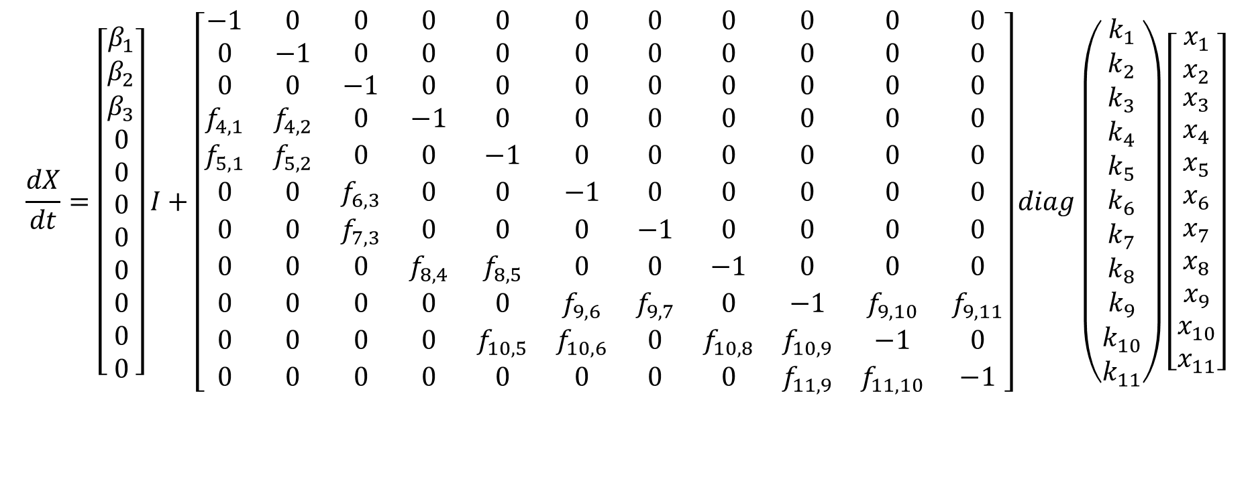
$$\frac{dX}{dt}=BI+AKX$$
$$\frac{dX}{dt}=\left[\begin{matrix}β_{1} \\ β_{2} \\ \begin{aligned}β_{3} \\ 0 \\ 0 \\ 0 \\ 0 \\ 0 \\ 0 \\ 0 \\ 0\end{aligned}\end{matrix}\right]I+\left[\begin{matrix}−1 & 0 & 0 & 0 & 0 & 0 & 0 & 0 & 0 & 0 & 0 \\ 0 & −1 & 0 & 0 & 0 & 0 & 0 & 0 & 0 & 0 & 0 \\ 0 & 0 & −1 & 0 & 0 & 0 & 0 & 0 & 0 & 0 & 0 \\ f_{4,1} & f_{4,2} & 0 & −1 & 0 & 0 & 0 & 0 & 0 & 0 & 0 \\ f_{5,1} & f_{5,2} & 0 & 0 & −1 & 0 & 0 & 0 & 0 & 0 & 0 \\ 0 & 0 & f_{6,3} & 0 & 0 & −1 & 0 & 0 & 0 & 0 & 0 \\ 0 & 0 & f_{7,3} & 0 & 0 & 0 & −1 & 0 & 0 & 0 & 0 \\ 0 & 0 & 0 & f_{8,4} & f_{8,5} & 0 & 0 & −1 & 0 & 0 & 0 \\ 0 & 0 & 0 & 0 & 0 & f_{9,6} & f_{9,7} & 0 & −1 & f_{9,10} & f_{9,11} \\ 0 & 0 & 0 & 0 & f_{10,5} & f_{10,6} & 0 & f_{10,8} & f_{10,9} & −1 & 0 \\ 0 & 0 & 0 & 0 & 0 & 0 & 0 & 0 & f_{11,9} & f_{11,10} & −1\end{matrix}\right]diag\left(\begin{matrix}k_{1} \\ k_{2} \\ \begin{aligned}k_{3} \\ k_{4} \\ k_{5} \\ k_{6} \\ k_{7} \\ k_{8} \\ k_{9} \\ k_{10} \\ k_{11}\end{aligned}\end{matrix}\right)\left[\begin{matrix}x_{1} \\ x_{2} \\ \begin{aligned}x_{3} \\ x_{4} \\ x_{5} \\ x_{6} \\ x_{7} \\ x_{8} \\ x_{9} \\ x_{10} \\ x_{11}\end{aligned}\end{matrix}\right]$$

